Slide 1


Department of Computer Engineering
DJSCE
Mumbai University
2025-26
ADAPT‑Synthetix
Viraj Sanghavi
60004240123
Archit Prabhu
60004240228
Arya Thakkar
60004240241
Raj Kunjadiya
60004240138
Under the guidance of
Dr. Chetashri Bhadane (Comps)
Project Guide

Slide 2
AGENDA
Introduction
Need of the System
Existing Solutions
Literature Survey
Gaps identified
Problem Statement
Proposed Solution
Flow of system
Statistics
Data sources
Frontend Example
References
Conclusion

Slide 3

Introduction
Automatic Speech Recognition (ASR): Technology that converts human speech into text for applications such as virtual assistants, transcription systems, and voice-controlled interfaces.
Performance Limitation: ASR systems achieve high accuracy in controlled environments but show significant performance degradation in noisy real-world conditions.
Real-World Challenge: Environments like busy streets, hospitals, and industrial zones introduce noise, accent variation, and speech distortion, increasing transcription errors.
Core Problem: Existing ASR models rely on static training datasets and cannot automatically adapt to new acoustic conditions or recurring recognition failures.
Proposed Innovation: ADAPT-Synthetix introduces a closed-loop framework that detects ASR errors and generates targeted synthetic speech data to continuously improve model robustness.

Slide 4

Need for the System
Data Scarcity Problem: Collecting large-scale real-world speech data covering every noise condition, accent, and environment is costly and practically infeasible.
Performance Failure in Real Environments: Existing ASR systems exhibit high error rates in noisy and safety-critical scenarios such as urban navigation, healthcare communication, and industrial operations.
Lack of Adaptive Learning: Current ASR models require manual data collection and retraining, preventing automatic improvement from real-world transcription failures.
Privacy Constraints: Domains such as healthcare and emergency services restrict access to real speech recordings, limiting the availability of training data.
Need for Automated Augmentation: A system capable of generating targeted synthetic speech based on detected errors is required to continuously improve ASR robustness and reliability.

Slide 5
Literature Survey - Related to Existing Systems
Existing Solutions
Apple Personalized ASR: Focuses on speaker adaptation and voice personalization but provides limited robustness against diverse environmental noise conditions.
NVIDIA Riva: Enables customizable ASR deployment; however, dataset selection and model retraining require significant manual human intervention.
Amazon Alexa Systems: Utilize post-processing language correction techniques that fix transcription errors after occurrence rather than improving acoustic learning.
Google Cloud Speech-to-Text: Offers predefined device and environment profiles but lacks continuous adaptation based on real-time recognition failures.
Limitation of Current Approaches: Existing solutions operate using open-loop training pipelines without automated feedback mechanisms to identify errors and generate corrective training data.

Slide 6
Literature Survey (in form of table)
Paper Name | Journal/Conference Name and Year | Methodology | Gaps
Sorry, I Didn’t Catch That | Together AI Report, 2026 | Benchmarking multiple state-of-the-art ASR models in real-world navigation environments | High transcription errors in noisy urban conditions; lacks adaptive correction mechanism
Benchmarking STT in Emergency Medical Dialogues | Benchmarking STT in Emergency Medical Dialogues | Benchmarking STT in Emergency Medical Dialogues | Benchmarking STT in Emergency Medical Dialogues
When De-noising Hurts: Analysis of Speech Enhancement for ASR | When De-noising Hurts: Analysis of Speech Enhancement for ASR | When De-noising Hurts: Analysis of Speech Enhancement for ASR | When De-noising Hurts: Analysis of Speech Enhancement for ASR
MEDSAGE: Enhancing Robustness using Synthetic Dialogues | MEDSAGE: Enhancing Robustness using Synthetic Dialogues | MEDSAGE: Enhancing Robustness using Synthetic Dialogues | MEDSAGE: Enhancing Robustness using Synthetic Dialogues

Slide 7
Gaps Identified
Non-Targeted Data Augmentation: Current augmentation techniques apply random noise instead of addressing specific acoustic or phonetic failure cases.
Limited Environmental Adaptability: Present systems struggle to adapt dynamically to diverse real-world noise conditions and changing acoustic environments.
Accent and Linguistic Bias: High Word Error Rates persist for regional accents and non-native speakers due to insufficient representative training data.
Manual Retraining Dependency: Most ASR improvement pipelines require human intervention for dataset collection, labeling, and model fine-tuning.

Slide 8
Problem Statement
To develop a closed-loop, error-adaptive framework that automatically identifies transcription failures in Automatic Speech Recognition (ASR) systems and generates targeted synthetic speech data to address specific acoustic and linguistic blind spots, thereby reducing Word Error Rate (WER) and improving robustness in real-world noisy environments.

Slide 9
Proposed solution
ASR Module (The Ear): Utilization of the Wav2Vec 2.0 framework to perform speech recognition and identify low-confidence or incorrectly transcribed words.
TTS Module (The Voice): A multi-stage Text-to-Speech pipeline using MeloTTS, XTTS-v2, and Fish Speech to generate diverse synthetic speech samples with variations in accent, tone, and speaking style.
Adaptive Feedback Loop (The Brain): Automated analysis of ASR errors to determine acoustic failure types such as noise interference, pronunciation variation, or environmental distortion.
Targeted Data Augmentation: Generation of synthetic speech combined with environmental, acoustic, and device-based noise to simulate real-world failure conditions.
Model Retraining and Optimization: Continuous fine-tuning of the ASR model using a mixture of real and generated data to iteratively reduce Word Error Rate and improve robustness.

Slide 10
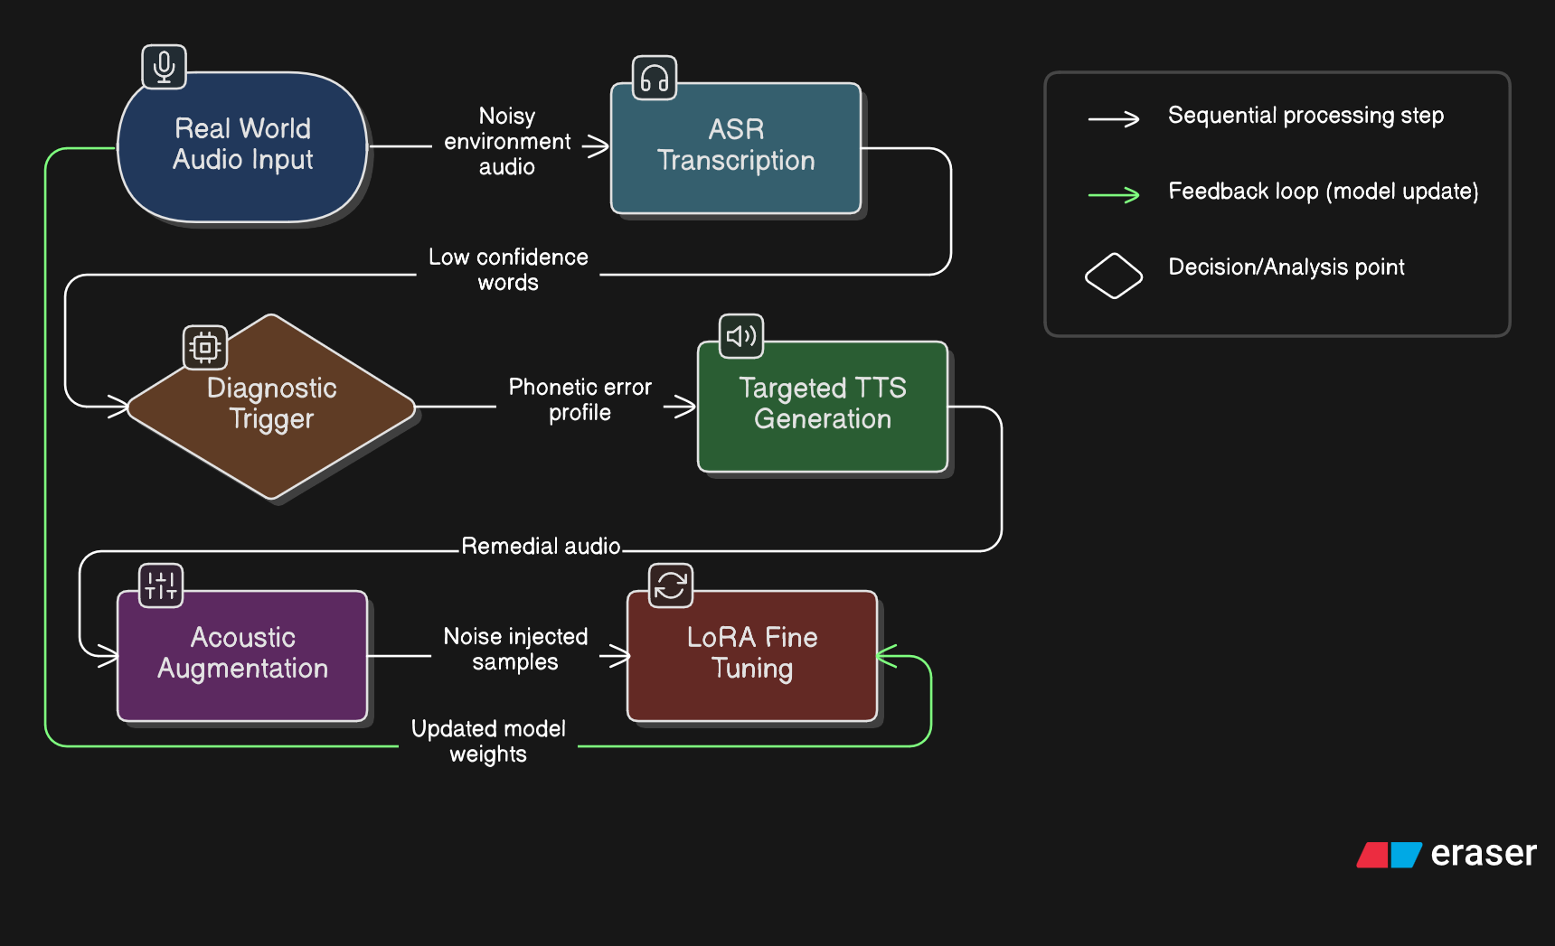
Flow of System

Slide 11
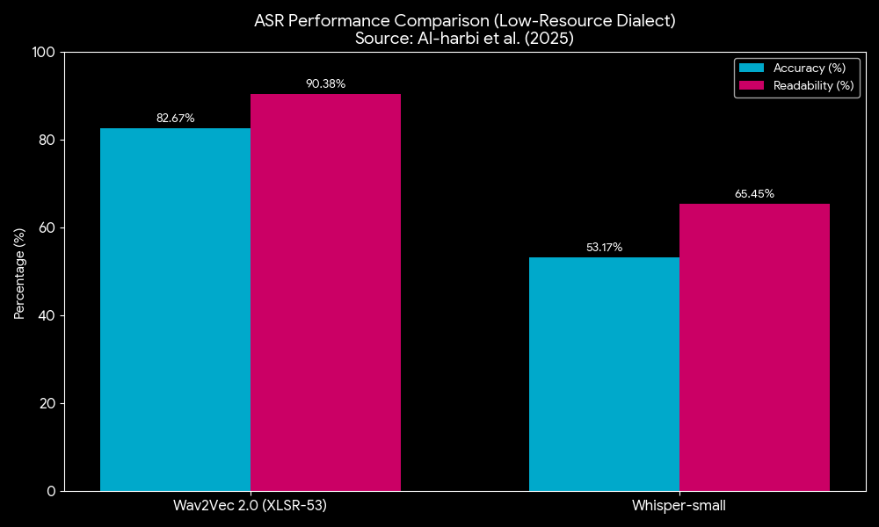
Statistics
One of the most critical decisions in our project was choosing the right ASR engine. While OpenAI’s Whisper is a household name, recent 2025 research from Al-harbi et al. proves that it struggles significantly in low-resource and specialized environments.
As you can see on the screen, in head-to-head testing on the Badini Kurdish dialect which serves as our proxy for low-resource, high-complexity speech Wav2Vec 2.0 (XLSR-53) achieved 82.67% accuracy, while Whisper-small lagged behind at 53.17%. That is a nearly 30% performance gap.

Slide 12
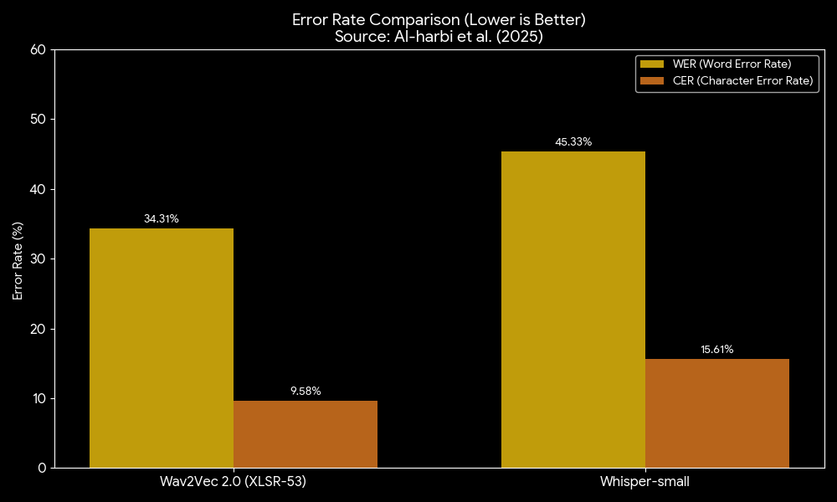
Statistics
To understand why we chose this model, we have to look at the level of the errors. we are looking errors among the characters and phonemes.
Looking at the Character Error Rate (CER), Wav2Vec 2.0 achieved a remarkable 9.58%, whereas Whisper was over 15%. In a closed-loop system, a low CER is vital. It means even when the model gets a word wrong, it is phonetically 'close' to the truth.

Slide 13
Data sources
LibriSpeech Dataset: Used as clean, high-quality speech data for baseline ASR model training and performance benchmarking.
Mozilla Common Voice: Provides diverse, real-world speech recordings with multiple accents and noisy environments for robustness testing.
VCTK Corpus: Utilized for modeling regional accents and speaker variability required for synthetic speech generation.
Multilingual LibriSpeech (MLS): Supports multilingual and cross-accent training to improve generalization capability of the ASR system.
LibriVox Audio Data: Serves as a large-scale raw speech source offering phonetic diversity for synthetic augmentation and experimentation.

Slide 14
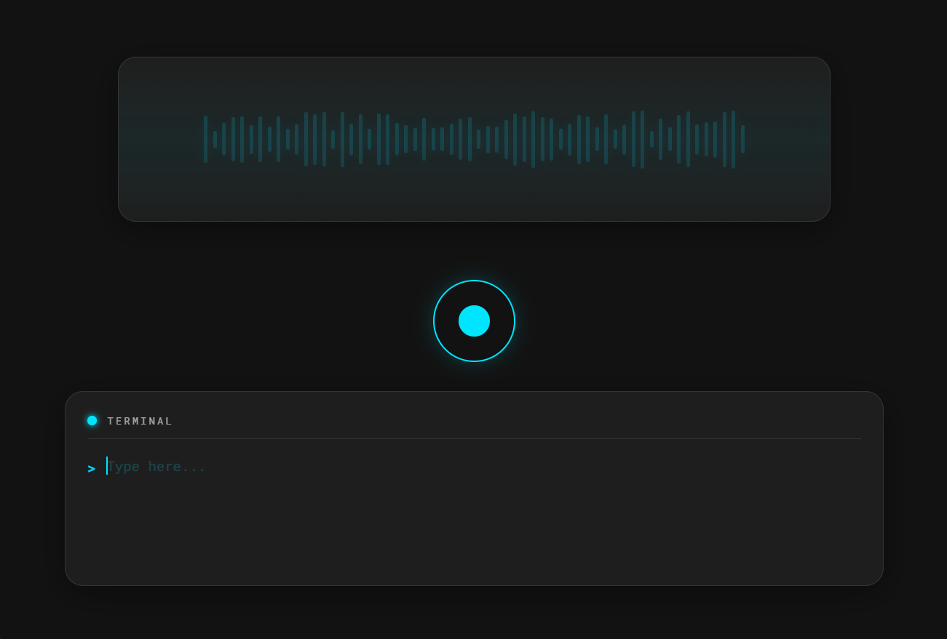
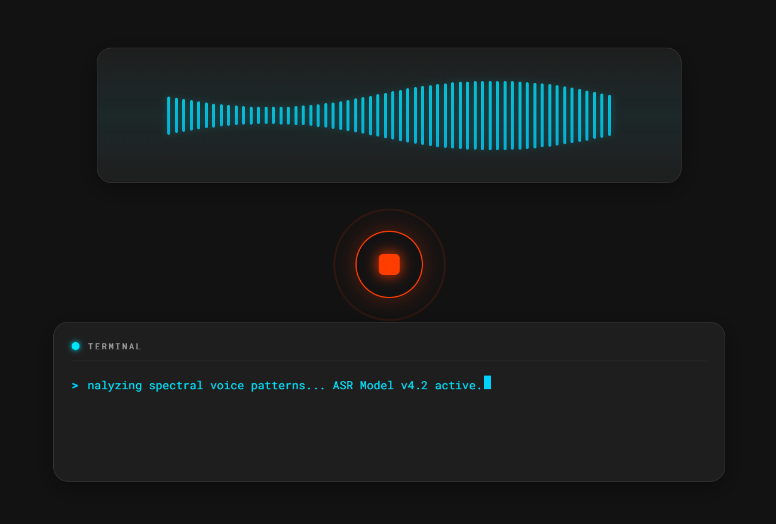
Frontend Example

Slide 15
References
Paper Name | Author(s) | Journal/Publication Source
wav2vec 2.0: A Framework for Self-Supervised Learning of Speech Representations | Alexei Baevski, Henry Zhou, Abdelrahman Mohamed, Michael Auli | Neural Information Processing Systems (NeurIPS), 2020
XTTS: A Massively Multilingual Zero-Shot Text-to-Speech Model | Eduardo Casanova, Christopher Shulby, Arnaldo Candido Jr., et al. | arXiv Preprint, 2024
Style Tokens: Unsupervised Style Modeling, Control and Transfer in End-to-End Speech Synthesis | Yuxuan Wang, Daisy Stanton, Yu Zhang, et al. | Google Research / ICML Workshop, 2018
Generating Synthetic Audio Data for Attention-Based Speech Recognition Systems | Nick Rossenbach, Ralf Schluter, Hermann Ney | INTERSPEECH Conference, 2020
Unsupervised Cross-Lingual Representation Learning for Speech Recognition | Alexis Conneau, Alexei Baevski, Ronan Collobert, et al. | arXiv Preprint, 2020

Slide 16
Conclusion
ADAPT-Synthetix proposes a closed-loop, error-adaptive framework aimed at improving the reliability of Automatic Speech Recognition systems in real-world environments. By automatically identifying transcription errors and generating targeted synthetic speech data, the system enables continuous model improvement without extensive manual intervention. The proposed approach enhances robustness against noise, accent variation, and environmental distortions, making ASR systems more accurate, scalable, and suitable for practical safety-critical applications.

Slide 17
THANK YOU !!

